Slide 1








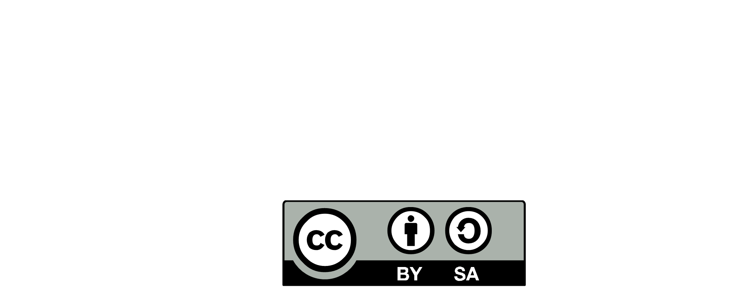

Architecture
Community
Enterprise
& Portfolio
PRODUCT VISION
VALUE CHAIN
OPERATING MODEL
PROCESS IMPROVEMENTS
FUNCTIONAL ROADMAP
PRODUCT VALUE PROPOSITION
IS PORTFOLIO
FUNCTIONAL DEBT
OBSOLESCENCE MANAGEMENT
DECOMMISSIONING
SYSTEM ENGINEERING
ARCHITECTURE STUDIES
INTEGRATION STRATEGY
FUNCTIONAL CONTRACT
FUNCTIONAL DEPENDENCY MIGRATION STRATEGY
DIAGNOSIS
WHAT IF SCENARIO
IS PROJECTION & PLANNING
PROMOTE
MARKETING ARCHITECTURE
PRODUCT SERVICES
SERVICE LEVEL
PRODUCT
ARCHITECT
CONNECT THE DOTS
Global & local dialog
DECISION MAKER
TRADE OFF
BUSINESS
SPONSOR
PRODUCT
OWNER
END USER*
CONNECT THE DOT
Promote Reference Architecture
EXPLAIN, CONTEXTUALIZE
END USER
PROBLEM SOLVING
KNOW YOUR CUSTOMER
USER EXPERIENCE
PAIN POINT IDENTIFICATION
FUNCTIONAL STUDIES
PRODUCT LIFE CYCLE
FROM IDEATION TO RETIREMENT
PRODUCT AS A SERVICE
FITNESS FUNCTION
PRODUCT ARCHITECTURE
PRODUCT VISION
BUSINESS & FUNCTIONNAL ARCHITECTURE
EVOLUTIONARY ARCHITECTURE
RISK MANAGEMENT
Business
Domain
TEAM
LEADER
Local Coaching
Mentoring
UX
TEAM
LEADER
UX
TEAM
LEADER
UX
DELIVERY
SQUAD
DELIVERY
SQUAD
DELIVERY
SQUAD
DEV.
TECH
LEAD
DEV.
TECH
LEAD
DEV.
TECH
LEAD
END USER*
- CLIENT
- BUSINESS
- EMPLOYEE
- PARTNER
PRODUCT ARCHITECT
DESIGNED BY :

